Slide 1
Docker Devops
Phaniraj

Slide 2
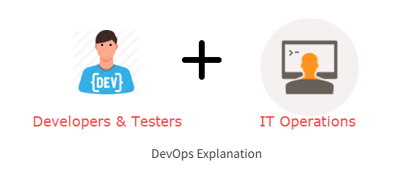
What is Devops?
DevOps is a collaboration between Development and IT Operations to make software production and Deployment in an automated & repeatable way.
The full form of ‘DevOps’ is a combination of ‘Development’ and ‘Operations.’

Slide 3
Why is Devops needed?
Before DevOps, the development and operation team worked in complete isolation.
Testing and Deployment were isolated activities done after design-build. Hence they consumed more time than actual build cycles.
Without using DevOps, team members spend a large amount of their time testing, deploying, and designing instead of building the project.
Manual code deployment leads to human errors in production.
Coding & operation teams have separate timelines and are not synch, causing further delays.

Slide 4
How is DevOps different from traditional IT
Old Process:
After placing an order for new servers, the Development team works on testing. The Operations team works on extensive paperwork as required in enterprises to deploy the infrastructure.
Projections about failover, redundancy, data center locations, and storage requirements are skewed as no inputs are available from developers who have deep knowledge of the application.
The operations team has no clue about the progress of the Development team. The operations team develops a monitoring plan as per their understanding.
Before going go-live, the load testing crashes the application, and the release is delayed.

Slide 5
The new way of deployment and operations
After placing an order for new servers Development and Operations team work together on the paperwork to set up the new servers. This results in better visibility of infrastructure requirements.
Projections about failover, redundancy, disaster recovery, data center locations, and storage requirements are pretty accurate due to the inputs from the developers.
In DevOps, the Operations team is completely aware of the developers’ progress. Operations teams interact with developers and jointly develop a monitoring plan that caters to IT and business needs. They also use advanced Application Performance Monitoring (APM) Tools.
Before going go-live, the load testing makes the application a bit slow. The development team quickly fixes the bottlenecks, and the application is released on time.

Slide 6
Why Devops is used?
DevOps allows Agile Development Teams to implement Continuous Integration and Continuous Delivery, which helps them launch products faster into the market.
Predictability
Reproducibility
Maintainability
Notes:
1. Predictability: DevOps offers a significantly lower failure rate of new releases.
2. Reproducibility: Version everything so that earlier versions can be restored anytime.
3. Maintainability: Effortless recovery process in the event of a new release crashing or disabling the current system.
4. Time to market: DevOps reduces the time to market up to 50% through streamlined software delivery. It is particularly the case for digital and mobile applications.
5. Greater Quality: DevOps helps the team improve application development quality by incorporating infrastructure issues.
6. Reduced Risk: DevOps incorporates security aspects in the software delivery lifecycle, and it helps reduce defects across the lifecycle.
7. Resiliency: The Operational state of the software system is more stable, secure, and changes are auditable.
8. Cost Efficiency: DevOps offers cost efficiency in the software development process, which is always an aspiration of IT management.
9. Breaks larger code base into small pieces: DevOps is based on the agile programming method. Therefore, it allows breaking larger codebases into smaller and manageable chunks.

Slide 7
When not to adopt DevOps?
It should not be used in mission-critical applications like banks, power and other sensitive data sites.
Such applications need strict access controls on the production environment, a detailed change management policy, and access control policy to the data centers.

Slide 8
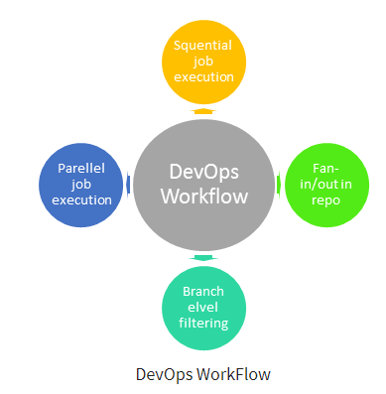
DevOps Workflow

Slide 9
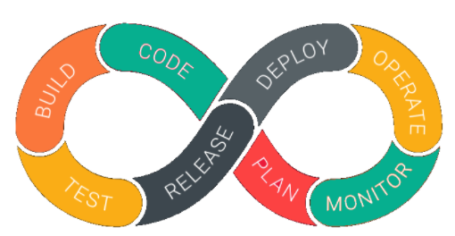
DEVops life cycle
Notes:
Stage 1) Continuous Development:
This practice spans the planning and coding phases of the DevOps lifecycle. Version-control mechanisms might be involved.
Stage 2) Continuous Integration:
This software engineering practice develops software by frequently integrating its components. It helps to ensure that changes in the source code do not break the build or cause other problems.
Stage 3) Continuous Testing:
This DevOps lifecycle stage incorporates automated, prescheduled, continued code tests as application code is written or updated. Such tests can be written manually or in conjunction with continuous integration tools.
Stage 4) Continuous Deployment:
The deployment process takes place continuously in this DevOps lifecycle phase. It is performed so that any changes made in the code should not affect the functioning of a high traffic website.
Stage 5) Continuous Monitoring:
During this phase, developers collect data, monitor each function, and spot errors like low memory or server connection are broken. For example, when users log in, they should access their account, and a failure to do so means there’s a problem with your application.
Stage 6) Continuous Feedback:
Continuous feedback is like a progress report. In this DevOps stage, the software automatically sends out information about performance and issues experienced by the end-user. It’s also an opportunity for customers to share their experiences and provide feedback.
Stage 7) Continuous Operations:
It is the last, shortest, and most straightforward phase of DevOps. It also involves automating the application’s release and all these updates that help you keep cycles short and give developers and provide more time to focus on developing.

Slide 10
Major dev ops tools
Version Control Tool: Git (GitLab, GitHub, Bitbucket)
Build Tool: Maven
Continuous Integration Tool: Jenkins
Configuration Management Tool: Chef
Configuration Management Tool: Puppet
Project Management: Jira and Confluence

Slide 11
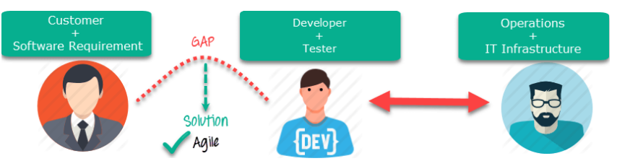
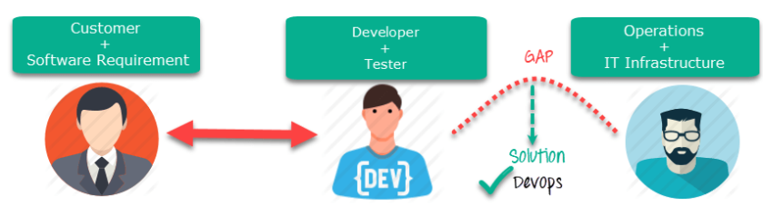
DevOps Vs Agile
Notes:
Agile addresses gaps in Customer and Developer communications
DevOps addresses gaps in Developer and IT Operations communications

Slide 12
Agile
Emphasize breaking down barriers between developers and management.
Addresses gaps between customer requirements and development teams.
Focuses more on functional and non-functional readiness
Agile development pertains mainly to the company’s way development is thought out.
Agile development emphasises training all team members to have varieties of similar and equal skills. So that, when something goes wrong, any team member can get assistance from any member in the absence of the team leader.
Agile development manages on “sprints”. It means that the timetable is much shorter (less than a month), and several features are to be produced and released in that period.

Slide 13
devops
DevOps is about software deployment and operation teams.
Addresses the gap between the development and Operation team
It focuses on operational and business readiness.
DevOps emphasises deploying software in the most reliable and safest ways that aren’t always the fastest.
DevOps likes to divide and conquer, spreading the skill set between the development and operation teams. It also maintains consistent communication.
DevOps strives for consolidated deadlines and benchmarks with significant releases rather than smaller and more frequent ones.

Slide 14
DevOps Principles
1. Customer-Centric Action: The DevOps team must constantly take customer-centric action to invest in products and services.
2. End-To-End Responsibility: The DevOps team needs to provide performance support until they become end-of-life. This enhances the level of responsibility and the quality of the products engineered.
3. Continuous Improvement: DevOps culture focuses on continuous improvement to minimize waste, and it continuously speeds up the improvement of products or services offered.
4. Automate everything: Automation is a vital principle of the DevOps process, and this is not only for software development but also for the entire infrastructure landscape.
5. Work as one team: In the DevOps culture, the designer, developer, and tester are already defined, and all they need to do is work as one team with complete collaboration.
6. Monitor and test everything: Monitor and test everything: The DevOps team needs robust monitoring and testing procedures.

Slide 15
Who is Devops engineer?
An IT professional who works with software developers, system operators, and other production IT staff to administer code releases.
DevOps should have hard and soft skills
Should have basics of Software development languages.
Notes:
A DevOps Engineer is an IT professional who works with software developers, system operators, and other production IT staff to administer code releases. DevOps should have hard and soft skills to communicate and collaborate with development, testing, and operations teams.
The DevOps approach needs frequent, incremental changes to code versions, requiring frequent deployment and testing regimens. Although DevOps engineers need to code occasionally from scratch, they must have the basics of software development languages.
A DevOps engineer will work with development team staff to tackle the coding and scripting needed to connect code elements, like libraries or software development kits.

Slide 16
Roles, Responsibilities, and Skills of a DevOps Engineer
Able to perform system troubleshooting and problem-solving across platform and application domains.
Manage project effectively through open, standards-based platforms
Increase project visibility thought traceability
Improve quality and reduce development cost with collaboration
Analyse, design and evaluate automation scripts & systems
Ensuring critical resolution of system issues by using the best cloud security solutions services
DevOps engineers should have the soft skill of problem-solver and quick-learner

Slide 17
DevOps Automation Tools
Infrastructure Automation
Configuration Management
Deployment Automation
Performance Management
Log Management
Monitoring

Slide 18
Infrastructure Automation
Amazon Web Services (AWS): Being a cloud service, you do not need to be physically present in the data center.
Azure
Notes:
Also, they are easy to scale on-demand. There are no up-front hardware costs, and it can be configured to automatically provision more servers based on traffic.

Slide 19
Configuration Management
Chef: It is a valuable DevOps tool for achieving speed, scale, and consistency. It can be used to ease out complex tasks and perform configuration management. The DevOps team can avoid making changes across ten thousand servers with this tool. Instead, they need to make changes in one place, automatically reflected in other servers.

Slide 20
Deployment Automation
Jenkins: This tool facilitates continuous integration and testing. It helps to integrate project changes more efficiently by quickly finding issues as soon as a built is deployed.

Slide 21
What is the future of DevOps?
Organizations are shifting in their needs to weeks and months instead of years.
We will see soon that DevOps engineers have more access and control of the end-user than any other person in the enterprise.
DevOps is becoming a valued skill for IT people. For example, a survey conducted by Linux hiring found that 25% of respondents’ job seekers are DevOps experts.
DevOps and continuous delivery are here to stay. Therefore companies need to change as they have no choice but to evolve. However, the mainstreaming of DevOps will take 5 to 10 years.

Slide 22
What is Docker?
Docker is a tool that allows developers, sys-admins etc. to easily deploy their applications in a sandbox (called containers) to run on the host operating system i.e. Linux.
It allows users to package an application with all of its dependencies into a standardized unit for software development.
Containerization is a technology that’s been around for a long time, but it’s seen new life with Docker.
Notes:
Docker is a platform for packaging, deploying, and running applications. Docker applications run in containers that can be used on any system: a developer’s laptop, systems on premises, or in the cloud.
Containerization: It packages applications as images that contain everything needed to run them: code, runtime environment, libraries, and configuration. Images run in containers, which are discrete processes that take up only as many resources as any other executable. It’s important to note that Docker containers don’t run in their own virtual machines, but share a Linux kernel. Compared to virtual machines, containers use less memory and less CPU. However, a Linux runtime is required for Docker. Implementations on non-Linux platforms such as macOS and Windows 10 use a single Linux virtual machine. The containers share this system.

Slide 23
Containers
Containers offer a logical packaging mechanism in which applications can be abstracted from the environment in which they actually run.
This gives developers the ability to create predictable environments that are isolated from the rest of the applications and can be run anywhere.
Notes:
This decoupling allows container-based applications to be deployed easily and consistently, regardless of whether the target environment is a private data center, the public cloud, or even a developer’s personal laptop.
The industry standard today is to use Virtual Machines (VMs) to run software applications. VMs run applications inside a guest Operating System, which runs on virtual hardware powered by the server’s host OS.
VMs are great at providing full process isolation for applications: there are very few ways a problem in the host operating system can affect the software running in the guest operating system, and vice-versa. But this isolation comes at great cost — the computational overhead spent virtualizing hardware for a guest OS to use is substantial.
Containers take a different approach: by leveraging the low-level mechanics of the host operating system, containers provide most of the isolation of virtual machines at a fraction of the computing power.

Slide 24
Setting up your computer
Download Docker Desktop for Windows from the following link:
https://docs.docker.com/desktop/windows/install/
WSL 2 backend
Download and install the Linux kernel update package.
Notes:
Windows 11 64-bit: Home or Pro version 21H2 or higher, or Enterprise or Education version 21H2 or higher.
Windows 10 64-bit: Home or Pro 2004 (build 19041) or higher, or Enterprise or Education 1909 (build 18363) or higher.
Enable the WSL 2 feature on Windows
You can now install everything you need to run Windows Subsystem for Linux (WSL) by entering this command in an administrator PowerShell or Windows Command Prompt and then restarting your machine. wsl --install
The following hardware prerequisites are required to successfully run WSL 2 on Windows 10 or Windows 11:
64-bit processor with Second Level Address Translation (SLAT)
4GB system RAM
BIOS-level hardware virtualization support must be enabled in the BIOS settings. For more information, see Virtualization.
Download and install the Linux kernel update package.

Slide 25
Installation setup
Double-click Docker Desktop Installer.exe to run the installer.
When prompted, ensure the Enable Hyper-V Windows Features or the Install required Windows components for WSL 2 option is selected on the Configuration page.
Follow the instructions on the installation wizard to authorize the installer and proceed with the install.
When the installation is successful, click Close to complete the installation process.
If your admin account is different to your user account, you must add the user to the docker-users group. Run Computer Management as an administrator and navigate to Local Users and Groups > Groups > docker-users. Right-click to add the user to the group. Log out and log back in for the changes to take effect.
Notes:
Docker run help-world

Slide 26
Docker commands
docker images: see a list of all images on your system.
docker run imageName: Runs the image.
docker ps: Shows you all containers that are currently running.
Docker rm containerid
Notes:
Docker ps – a
As a rule of thumb, I clean up containers once I'm done with them. To do that, you can run the docker rm command.
On deletion, you should see the IDs echoed back to you.
$ docker rm $(docker ps -a -q -f status=exited) : Use this for deleting all the images in one go.

Slide 27
Run MySQL In Docker
Start Mysql container
To start the container, type the command below in your terminal:
docker run --name mysql57 -p 3306:3306 -e MYSQL_ROOT_PASSWORD=1234 -d mysql/mysql-server:5.7
Create a Database:
docker exec -it mysql57 bash
mysql -h localhost -u root –p
Create a User for out-of-container access as the root access is not allowed.(Optional)
Now create the database using DDL command
Notes:
The command above, pulled image if not found in local repository and run mysql container in detached mode. Configure local port equals to container port and set root password to 1234.
Check your container running: docker ps
This command access the mysql container and allow to execute commands on database. Inside a container, type:
CREATE USER ‘sample_demo' IDENTIFIED BY 'java'; grant all on *.* to sample_demo'@'%' identified by '1234'; FLUSH PRIVILEGES;
CREATE DATABASE hello_java CHARACTER SET utf8 COLLATE utf8_general_ci;

